Slide 1


Personal Budget Application
Prepared By :-
20DCE012 – Stuti Bhatt
20DCE013 – Sanket Bhimani
20DCE016 – Khushbu Chauhan
20DCE019 – Yatharth Chauhan
Guided By :-
Prof. Mohammed Bohara

Slide 2
1
PROJECT DEFINITION

Slide 3
The project is based on finance management. Our app is used to manage budget and expenses.
The app track monthly and yearly finance record.
It’s help to invest in future to make life easier.
It’s good for save money and buy expensive things in future.

Slide 4
2
INTRODUCTION

Slide 5
The main purpose of this App is manage money in easy and proper way .
In this app we are providing month and year wise personal budget management.
In this app we are spent money in clothes, education, charity, House expenses, Entertainment, etc. So all the cost are counting and minus this cost from providing budget.
After the remaining amount are invest in good area for better future.
This app mainly help in manage money and invest money in good stuff.

Slide 6
3
OBJECTIVES OF THIS SYSTEM

Slide 7
A personal budget app helps create financial stability by tracking expenses and following a plan, a budget makes it easier to pay bills on time, build an emergency fund, and save for major expenses such as a car or home. Overall, a budget puts a person on stronger financial footing for both the day-to-day and the long term.

Slide 8
4
CURRENT SYSTEM AND SCOPE OF THE SYSTEM

Slide 9
Current System
Calculate weekly, monthly and yearly expenses.
Show data through graph
Date-time of every budget expense
Category wise managing budget

Slide 10
Scope:
The scope of personal finance is vast. After all, personal finance is all about financial management wherein a person handles his finances by taking into account his budget and savings of the present to stock up resources for the future.
Personal budgets are usually created to help an individual or a household of people to control their spending and achieve their financial goals. Having a budget can help people feel more in control of their finances and make it easier for them to not overspend and save money.

Slide 11
5
FUTURE ENHANCEMENT

Slide 12
Utilization of current code with adding further function required.
Can link up with Bank.
Manually entry not required, It will be directly reflecting amount.

Slide 13
6
LIMITATION

Slide 14
Personal budget is the time requirement. You must spend a significant amount of time creating and managing your budget plan. It takes time to create a budget spread sheet and list all of your bills and obligations.

Slide 15
7
HARDWARE AND SOFTWARE SPECIFICATIONS

Slide 16
Software :
Hardware :
Android Operating System.
Android minimum version Android 5.0 Lollipop.
For developing app we are use android studio and for database we are use firebase.
Android Based Smart phone
Minimum 2 GB RAM required.
App size space required in ROM.

Slide 17
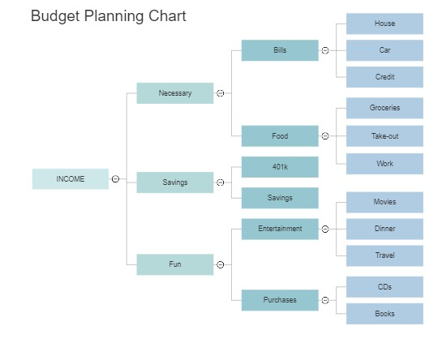
FLOW CHART
8

Slide 18
9 GANTT CHART
Research and Analysis
July
August
September
October
November
Designing
July
August
September
October
November
Implementing
July
August
September
October
November
Testing
July
August
September
October
November

Slide 19
10
CONCLUSION

Slide 20
Developing a personal budget and tracking all expenses and spending is a crucial aspect of personal finances. Set aside a fixed amount in a savings account, they say you should always have three months work of your living expenses in a savings account in case of emergencies. Lastly, educating the children early in life about personal finances should be a mandatory class in every school. Parents need to proactive in teaching their children about banking, credit card, interest rates, and credit. The importance of actually seeing my spending on my budget sheet was enlightening. Learn management of money and make future bright.

Slide 21
11
REFERENCES
Android Tutorial :
Javatpoint :- https://www.javatpoint.com/android-tutorial.
Youtube :- https://www.youtube.com/c/NeatRoots.
Firebase Tutorial :
Javatpoint :- https://www.javatpoint.com/firebase.
Youtube :- https://www.youtube.com/watch?v=b1bGrWrx5Mo.

Slide 22

THANK YOU

